Slide 1
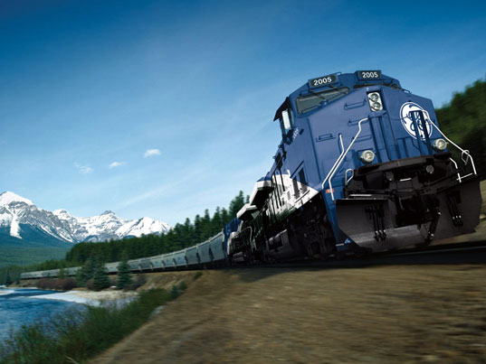
Railroad Block Signal
Railroad Block Signal Software Tool
Team Members:
Kenneth Truex
Chad Mason
Zachary McHenry
Christopher Diebold

Slide 2
Previous Goals
Task | Completion % | Kenneth Truex | Christopher Diebold | Chad Mason | Zachary McHenry | To Do
Obtain Requirement Document From GE | 100% | 50% | 50% | 0% | 0% | Ensure a full understanding of the “Shalls” associated with this project
Decide on IDE/Programming Language/Database Tools | 100% | 25% | 25% | 25% | 25% | Select a language and IDE/Tools that mesh well together

Slide 3
Previous Goals
Task | Completion % | Kenneth Truex | Christopher Diebold | Chad Mason | Zachary McHenry | To Do
Evaluate Selected Tools with Small Examples to Analyze Integration/Cohesiveness of Tools | 100% | 25% | 25% | 25% | 25% | Also include the skeleton infrastructure in order to connect to a database
Begin Drafting Design of Program and GUI | 100% | 0% | 0% | 50% | 50% | Create a basic GUI and sample code snippits

Slide 4
Milestone 1 Accomplishment Summary

Slide 5
Obtain Requirement Document From GE
At the conclusion of our second team meeting with Dan Ballesty, he informed us that he would sit down with the subject matter experts at GE and decide on what functionality they wanted the tool to provide them. Shortly after the meeting we received an email containing the
formalized list of requirements for the project. The document includes five requirements.

Slide 6
Requirements
I. Include formulas to calculate
1. Safe breaking Distance
2. Headway Calculations
3. Runtime Performance Calculations
4. Clear Time Calculations
5. Approach Locking Time Calculations
II. Ability to connect to Database
III. Perform analysis on data provided

Slide 7
Requirements
IV. Be able to display
1. Excel formatted spreadsheets
2. Track and Train Graphs
3. Train simulations
V. Output to specific file types

Slide 8
Test Plan
Compare calculations from our formulas to the ones given to us by GE.
Ensure functionality of current GUI layout(ie Ensure you can perform a feature tour and the GUI will not crash)
Ensure data can be successfully entered and then retrieved from our database and that the data entered and retrieved is correct

Slide 9
Decide on IDE/Programming Language/Database Tools
At the beginning of our third meeting with Dan Ballesty, we reviewed the requirements document and held an open conversation as to which tools/IDE/programming language/database software would provide the greatest amount of ease throughout the project. The decisions that we made were:
IDE: Visual Studio
Programming Language: C#/.NET
Tools: Windows Forms (For GUI), Photoshop for GUI design
Database Tools: MySQL

Slide 10
Evaluate Selected Tools with Small Examples to Analyze Integration/Cohesiveness of Tools:
As far as small examples and code snippets, we currently have working C# code that implements some of the basic classes that GE requires. We have a basic GUI created using Windows Forms with File and Display functionality. We also have a basic code sample in C# that will establish a database connection with a MySQL database and allow a user to enter queries.

Slide 11
Begin Drafting Design of Program and GUI
With the help of GE professionals, we completed the SDP at the conclusion of our most recent meeting held on 2/14. We also put the finishing touches on both the GUI plan document, created in Photoshop, and the actual coded GUI.

Slide 12
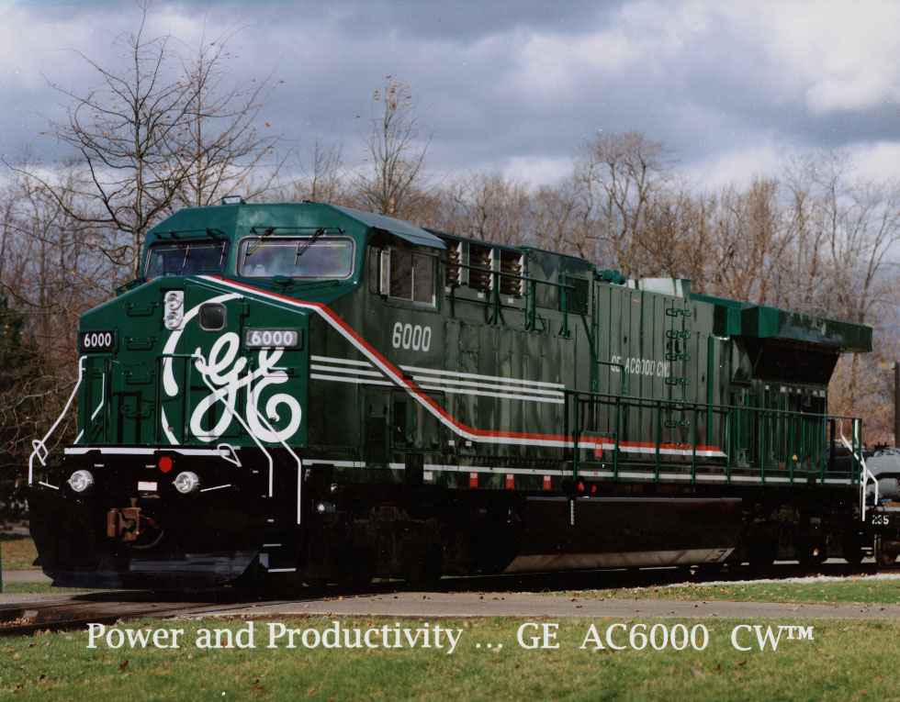
Next Milestone

Slide 13
Milestone 2
Parsing the database - Take our skeleton infrastructure of a database and add to it the functionality of information retrieval. Set it up so that the user can enter query commands and actually retrieve information stored in the database.
Do a GUI mockup and present to GE - Take our design documents of our GUI that we created in Photoshop and implement it into C# code. After completing the implementation, we will present it to Dan Ballesty for review and critique.

Slide 14
Milestone 2 Role Distribution
Task | Chad | Ken | Chris | Zach
Parsing the Database information | 0% | 100% | 100% | 0%
Do a GUI Mockup and present to GE | 100% | 0% | 0% | 100%

Slide 15

Any Questions?

